Slide 1



Mushroom Edibility Prediction
ISYE 7406 Presentation
Siham Elmali
Mary Washington

Slide 2
Table of content
Background
Problem Statement
Anatomy of a mushroom
Data Source
Exploratory Data Analysis
Data Processing and Feature Engineering
Feature Selection
Methodology
Results
Conclusions
References

Slide 3
Background
According to the U.S. Department of Agriculture, the average American eats approximately three pounds of mushrooms a year. Additionally, and in a recent report published by UCLA health, a review of 17 cancer studies between 1966 and 2022 showed that consuming 18 grams of mushrooms a day may lower cancer risks by up to 45% [1].
In another study conducted in Italy from Jan 1996—December 2016, researchers found that there were 443 mushroom poisonings, with Autumn being the peak season [2]. The species could only be identified in 397 of them.
Most mushroom species are commonly found in the wilderness and have shared characteristics. Their similarities make it extremely hard to distinguish between the ones that are edible and those that are poisonous.

Slide 4
Problem Statement
How to determine whether a mushroom is edible or poisonous ?
What key attributes can help us predict the edibility of a mushroom?
Performance Metrics: Precision, Recall, F-1 Score, Accuracy, and AUC

Slide 5
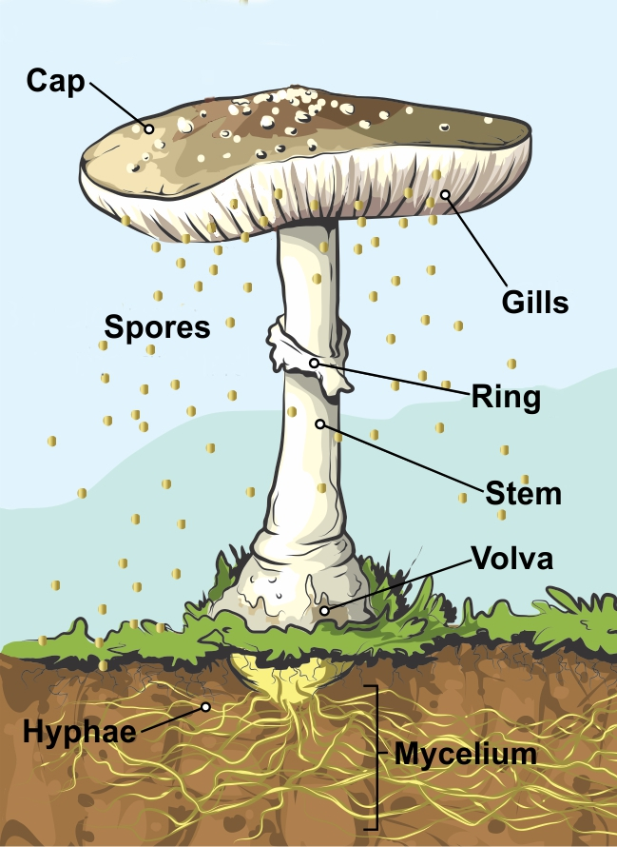
Anatomy of a mushroom
There are two main parts to a mushroom; an above-ground fruiting body that we are accustomed to, and an underground vast network of cells called mycelium [3][4].
Mycelium is a complex network of cells, like plant roots that spread under the forest floor searching for nutrients and forming interconnections with other fungi [3][4].
The umbrella-shaped fruiting body consists of :
Cap: The topmost part of the mushroom. Mushroom caps come in a variety of shapes (conical, ovate, flat, convex, bell-shaped, etc.), colors, sizes, and textures. They’re unique from one mushroom species to another [3][4].

Slide 6
Anatomy of a mushroom—cont.
Gills: A paper-like structures found underneath the cap. They come in different shapes, spacings, colors, etc.
Spores: Microscopic cells produced in the gills.
Ring: A tissue that can be found on the stem—it helps protect the mushroom.
Stem: Supports the cap and elevates it from the ground—this helps disperse spores into the wind or onto passing animals.
Volva: A layer of tissue that plays the role of a protection veil.
Hyphae: Microscopic tubes that interconnect and grow from the mycelium [3][4].

Slide 7

Data Source
The mushroom dataset was obtained from the UCI Machine Learning Repository.
61,069 observations and 20 variables (17 are nominal and 3 are metrical)
Contains information about different parts of a mushroom such as: cap (diameter, shape, surface type, color), gill (type of attachment, color, spacing), stem (heigh, width, root, surface type, color), habitat, season (summer, winter, fall, spring), etc.

Slide 8
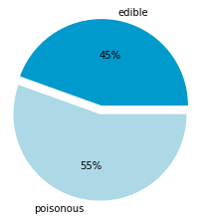
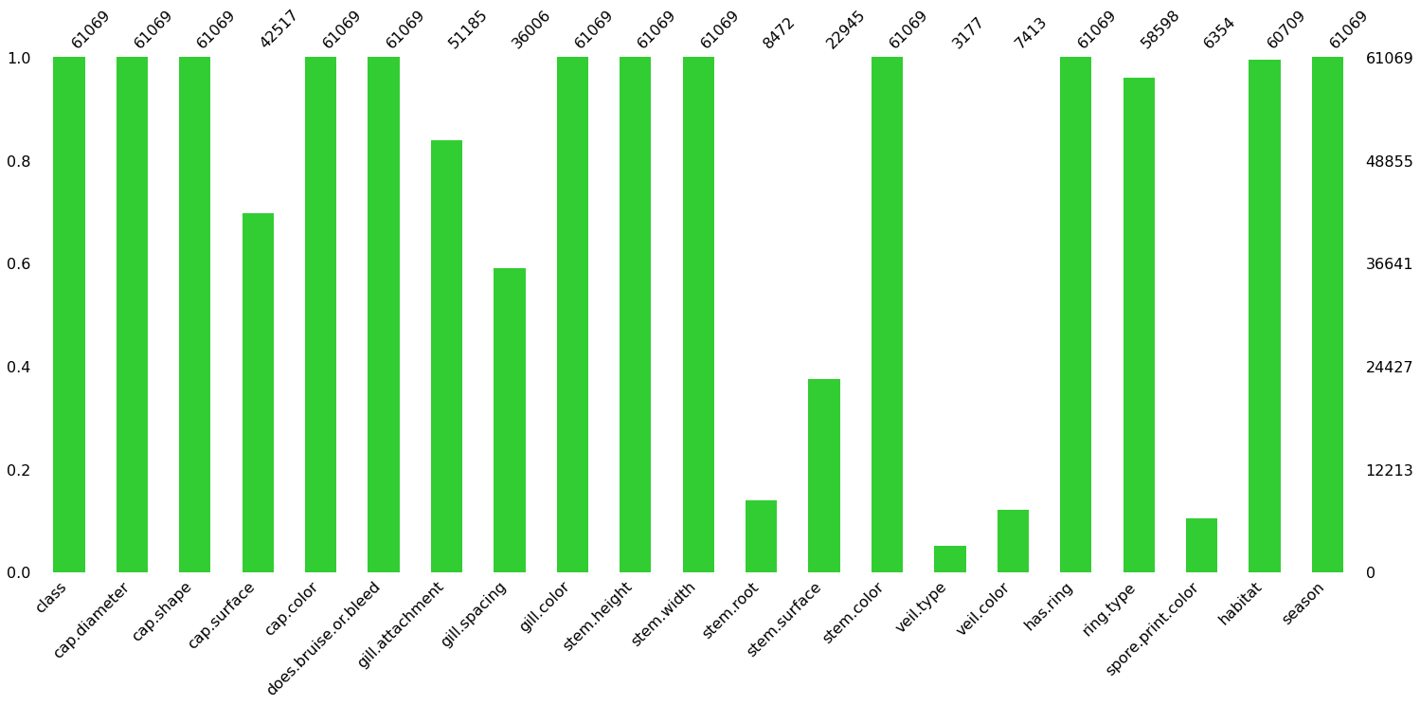
Exploratory Data Analysis
Missing values
Class
10 variables had missing values
Five variables had more than 70% missing values and had to be dropped
Remaining missing values were imputed using the most frequent value in their respective columns

Slide 9
Data Processing and Feature Engineering
Drop Columns with 70% or more missing values
Outlier Detection using IQR method
Outlier Removal
Missing value imputation using SimpleImputer() and most frequent value per column as strategy
One Hot Encoding Categorical Variables and Label Encoding Response Variable
Feature Selection using Shapley values (Random Forest as a model)

Slide 10
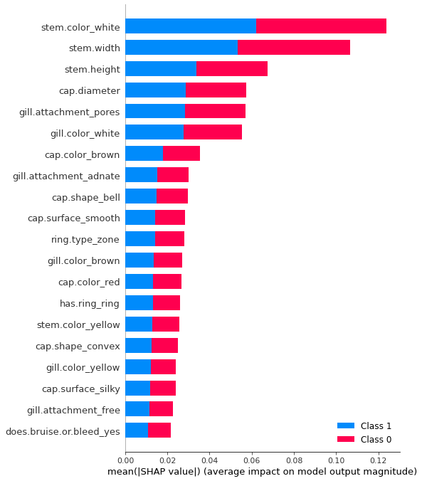

Feature Selection: Shapley features
Shapley (SHapley Additive exPlanations) values for feature importance/selection is a novel approach that calculates the average marginal contribution of each feature value across all possible combinations of features in a dataset [5].
The chosen features using “SHAP” Python package and Random Forest as a model are displayed on the right (class 1 is poisonous and class 0 is edible).

Slide 11
Methodology
Employ Shapley values for feature selection
Split data into training and testing sets using an 80/20 random split
Build several models (LDA, Logistic Regression, SVM, XGBoost, RF, Neural Network) on different dataset permutations (listed below) for comparison purposes
Full dataset
Full dataset without outliers
Subset dataset
Subset dataset without outliers

Slide 12
Methodology—cont.
Hyperparameter tuning using a grid search and a repeated stratified k-fold cross validation ( 5-fold, 3 repeats)
Performance metrics: Accuracy, Precision, F-1 Score, Recall, and AUC
We are prioritizing Recall because misclassifying poisonous mushrooms as edible carries a high risk (e.g., poisoning or even death in some cases)

Slide 13
Linear Discriminant Analysis (LDA)
Methodology: Models Explained
Logistic Regression
Uses Bayes classifier and assumes that the densities are multivariate normal with a common covariance estimated by within-sample covariance
Assumes X | Y = k is Gaussian for linear coefficients
Often more robust than LDA (doesn't make any assumptions about marginal distribution of X)
Links the model parameters to the independent X variables
Models response Y as a Bernoulli distribution

Slide 14
Support Vector Machine (SVM)
Methodology: Models Explained
Extreme Gradient Boosting (XGBoost)
Finds the hyperplane that maximizes the margin between the classes of the training data
Assigns the Lagrange multiplier to the training data. Only the training data with α ≠ 0 affects the final SVM classification
Implements Gradient Boosted decision trees
Decision trees are made sequentially where weights are given to all independent variables to predict results
Misclassified variables have their weight increased and then give their new weights to the next decision tree and so forth [6]

Slide 15
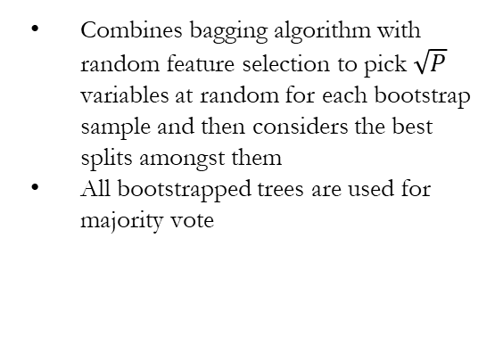
Random Forest
Methodology: Models Explained
Neural Network
Combines bagging algorithm with random feature selection to pick $\sqrt{P}$ variables at random for each bootstrap sample and then considers the best splits amongst them
All bootstrapped trees are used for majority vote
We used multi-layer perceptron
Uses backpropagation for training to update the input nodes on the errors from the output nodes. Then updates the weights and recomputes
We used Rectified Linear Unit (ReLU) and Logistic (Sigmoid) as activation functions for the hidden layer

Slide 16
Results: Full dataset
Models | Accuracy | Precision | Recall | F-1 Score | AUC
LDA | 0.7731 | 0.7995 | 0.7940 | 0.7967 | 0.8483
Logistic Regression | 0.7739 | 0.7987 | 0.7972 | 0.7980 | 0.8540
SVM | 0.9939 | 0.9907 | 0.9985 | 0.9946 | 0.9987
Random Forest | 0.9985 | 0.9981 | 0.9993 | 0.9987 | 0.9999
XGBoost | 0.8905 | 0.9028 | 0.9016 | 0.9022 | 0.9640
Neural Net | 0.9981 | 0.9972 | 0.9994 | 0.9983 | 1.0000

Slide 17
Results: Subset dataset (Shapley features)
Models | Accuracy | Precision | Recall | F-1 Score | AUC
LDA | 0.7084 | 0.7227 | 0.7776 | 0.7491 | 0.7626
Logistic Regression | 0.7057 | 0.7205 | 0.7753 | 0.7469 | 0.7641
SVM | 0.9530 | 0.9599 | 0.9560 | 0.9580 | 0.9925
Random Forest | 0.9938 | 0.9942 | 0.9947 | 0.9944 | 0.9996
XGBoost | 0.8660 | 0.8761 | 0.8860 | 0.8810 | 0.9378
Neural Net | 0.9931 | 0.9928 | 0.9950 | 0.9940 | 0.9997

Slide 18
Results: Full dataset without outliers
Models | Accuracy | Precision | Recall | F-1 Score | AUC
LDA | 0.7805 | 0.8151 | 0.7928 | 0.8038 | 0.8578
Logistic Regression | 0.7797 | 0.8106 | 0.7982 | 0.8043 | 0.8639
SVM | 0.9935 | 0.9924 | 0.9960 | 0.9942 | 0.9977
Random Forest | 0.9986 | 0.9984 | 0.9991 | 0.9987 | 1.0000
XGBoost | 0.9142 | 0.9309 | 0.9168 | 0.9238 | 0.9756
Neural Net | 0.9985 | 0.9981 | 0.9992 | 0.9986 | 1.0000

Slide 19
Results: Subset dataset without outliers
Models | Accuracy | Precision | Recall | F-1 Score | AUC
LDA | 0.6988 | 0.7158 | 0.7781 | 0.7457 | 0.7707
Logistic Regression | 0.7003 | 0.7155 | 0.7834 | 0.7479 | 0.7732
SVM | 0.9586 | 0.9712 | 0.9553 | 0.9631 | 0.9940
Random Forest | 0.9932 | 0.9929 | 0.9951 | 0.9940 | 0.9996
XGBoost | 0.8673 | 0.8794 | 0.8879 | 0.8836 | 0.9409
Neural Net | 0.9925 | 0.9906 | 0.9962 | 0.9934 | 0.9997

Slide 20
Conclusions
Since we want to prioritize recall (i.e., Percentage of poisonous mushrooms that were correctly classified), we see that Random Forest, Neural Network, and Support Vector Machine have the highest recall using all four different datasets (full data, full data without outliers, subset data, and subset data without outliers).
LDA and Logistic Regression models performed poorly on this highly categorical dataset.
Random Forest, Neural Network, and Support Vector Machine have the largest area under the roc curve or AUC (~ 1). This indicates that the models are capable of correctly separating the two classes of mushrooms (edible/poisonous).

Slide 21
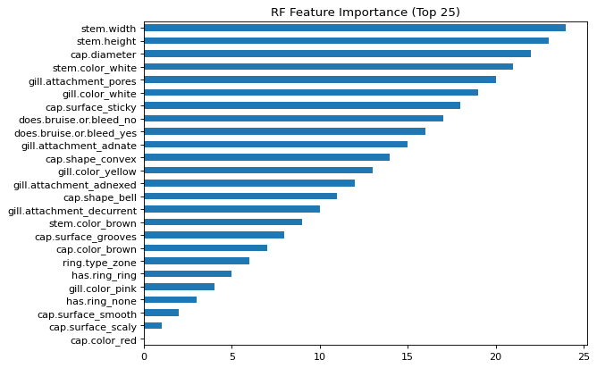
Conclusions—cont.
Based on Random Forest feature importance, the key attributes that can help us separate between poisonous and edible mushrooms are shown in the bar chart below:

Slide 22
References
“7 Health Benefits of Mushrooms”, Uclahealth, 24 Jan. 2022.
Cervellin G, Comelli I, Rastelli G, et al. Epidemiology and clinics of mushroom poisoning in Northern Italy: A 21-year retrospective analysis. Human & Experimental Toxicology. 2018.
Sayner, Adam. “A Guide to All the Parts of a Mushroom” GroCycle, 14 Sept. 2022.
Real Mushrooms. “Mushroom Anatomy: A Deep Dive into the Parts of a Mushroom” Real Mushrooms, 17 June 2022.
Rathi, Prakhar. “A Novel Approach to Feature Importance — Shapley Additive Explanations ” , Towardsdatascience, 2 July 2020.
“XGBoost” GeeksforGeeks, 11 July 2022.

